Slide 1
Infoblox NIOS
Introduction Himansu panda

Slide 2
Total 14 years of Experience in IT
Started in 2010 with expertise in Network Security and Monitoring.
Expertise in Network Security (Firewall, VPN & ISE), Infoblox ( DNS & DHCP & IPAM) , F5 LB and Cisco Thousand Eyes.
Completed 18 corporate training since in Infoblox, Efficient IP, F5 and Cisco Thousand Eyes and Zabbix.
Migrated and integrated complex IB and F5 environments.
Interested in Python AI/ML Algo implementation like Linear Regression, Random Forest and Decision Trees.

Slide 3
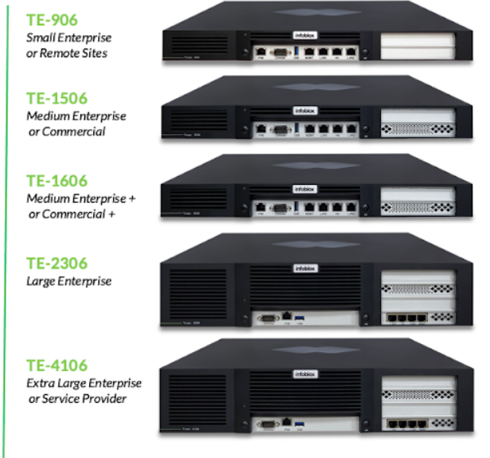
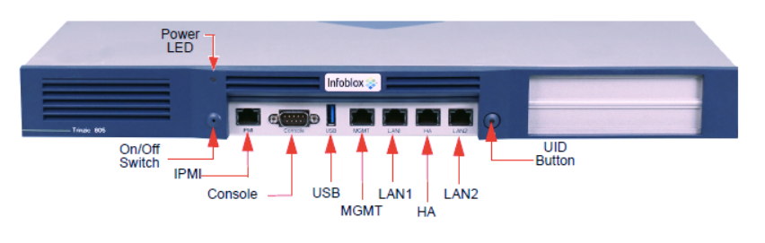
Infoblox NIOS
NIOS a IPAM Solution for in house ( DC & Campus ).
NIOS DDI comes with appliance-based infrastructure providing the service of DNS, DHCP and IP address Management.

Slide 4
Infoblox Deployment Methods
Standalone/Grid
Working of Standalone appliances for Small Offices Hub.
Grid architecture and Grid communication.
Grid Master & Grid Member.
High Availability Concept of Active Passive. ( HA)

Slide 5
Grid Basics
A Master Grid contains one Multi-Grid Master and one or more members.
The Multi-Grid Master and its members can be single appliances or HA (High Availability) pairs.
The Master Grid members cannot run any protocol, such as DNS or DHCP.
Their only role in the Master Grid is that of Multi-Grid Master candidates.
An appliance or HA pair that joins a Master Grid that already has a Multi-Grid Master automatically becomes a Multi-Grid Master candidate.

Slide 6
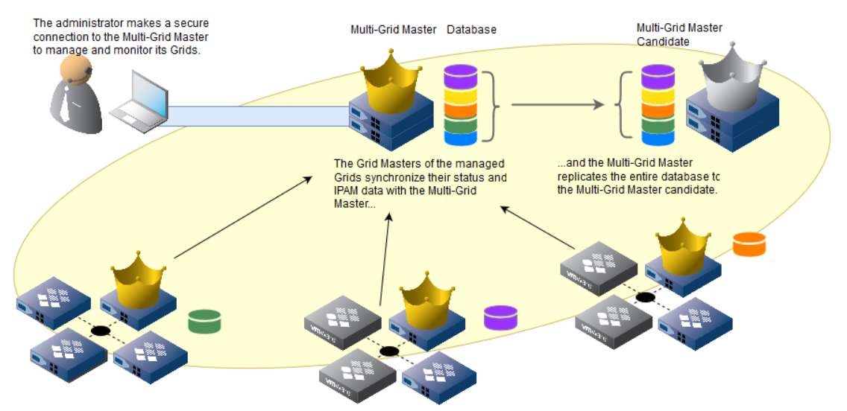

Slide 7
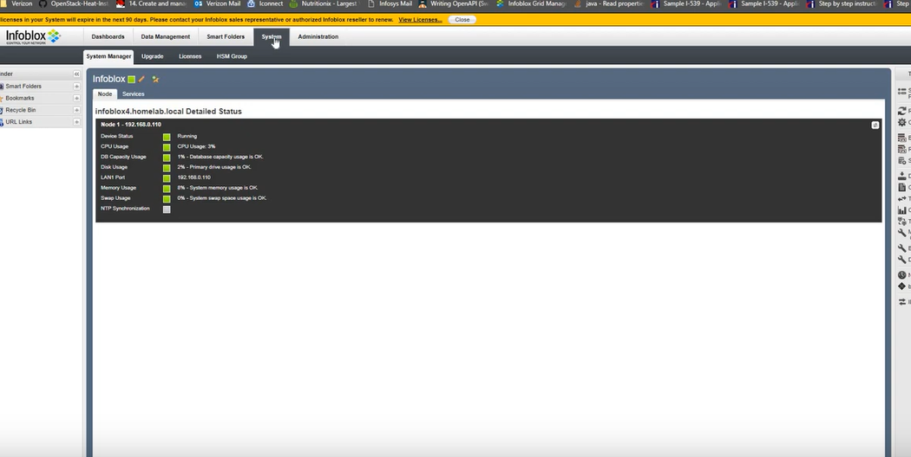

Slide 8
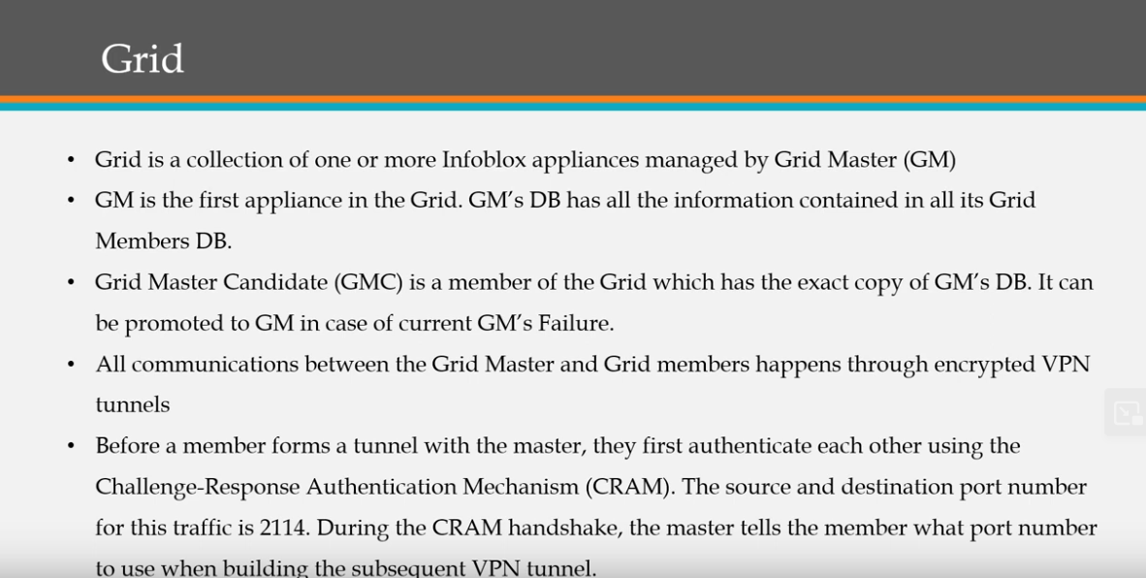

Slide 9
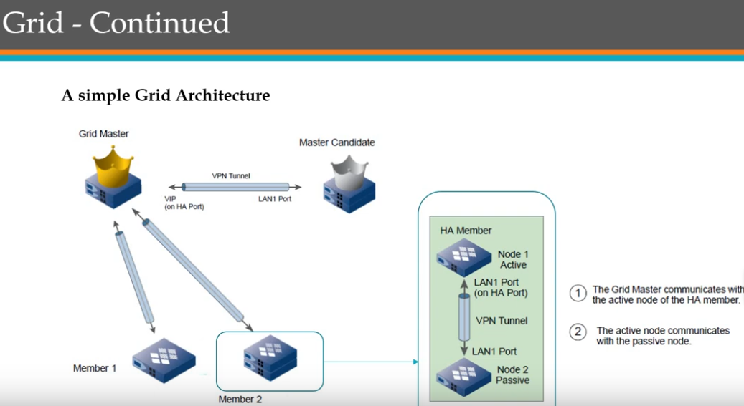

Slide 10
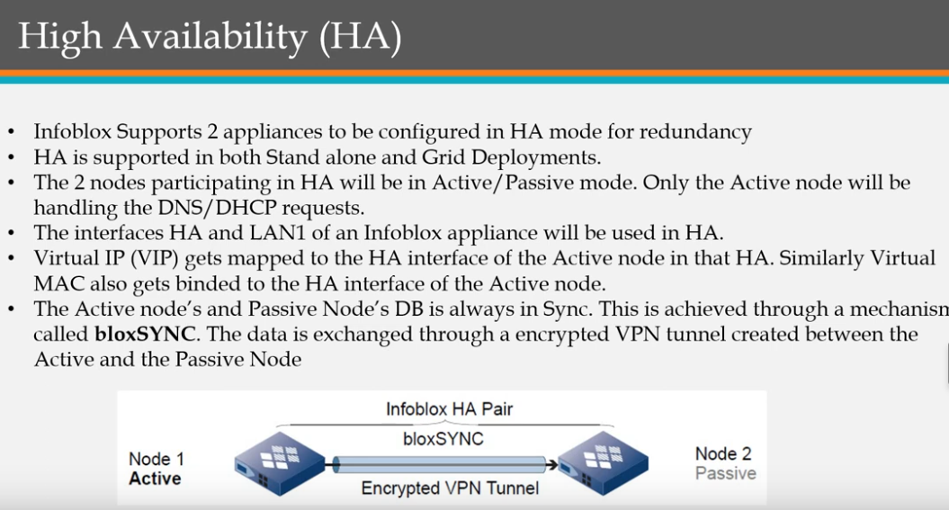

Slide 11
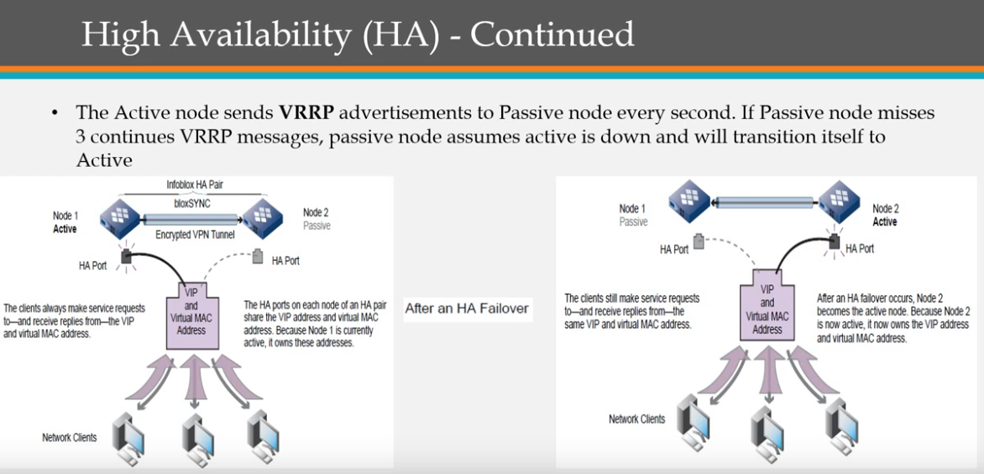

Slide 12
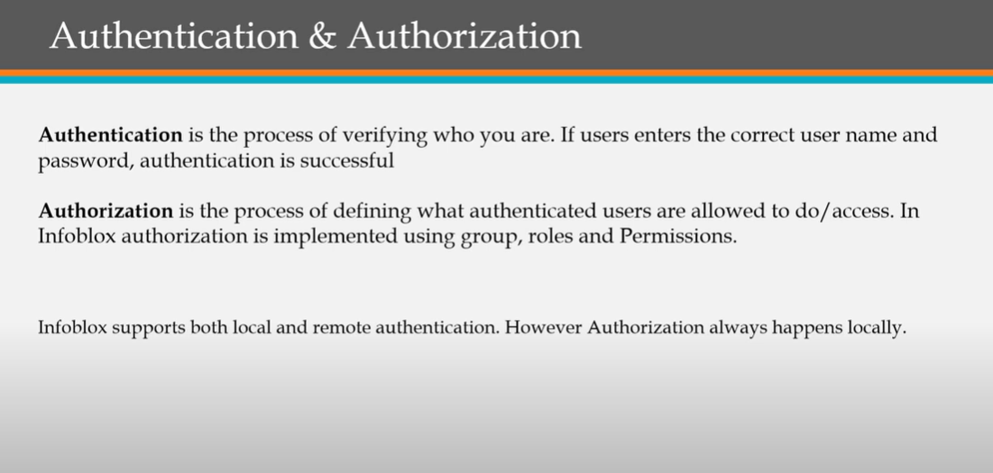

Slide 13
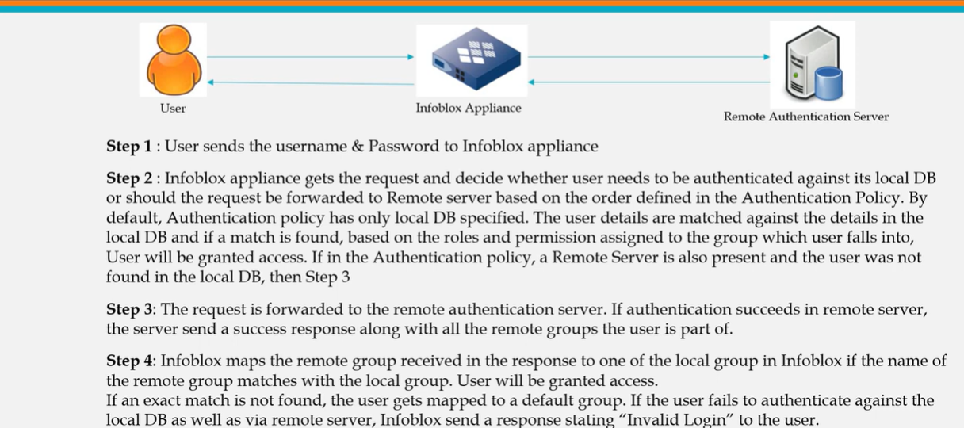

Slide 14
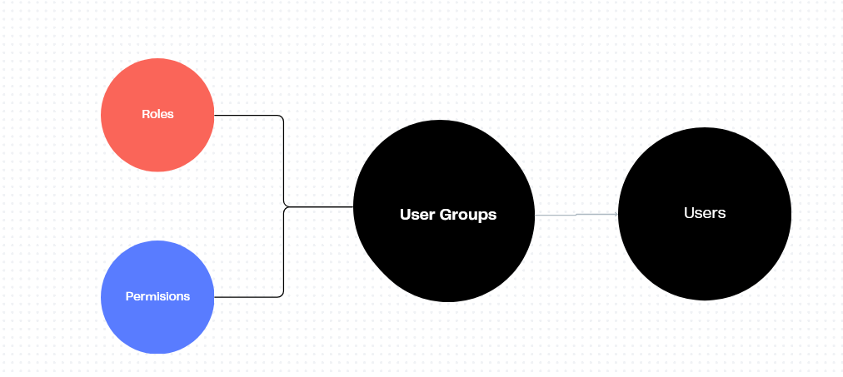

Slide 15
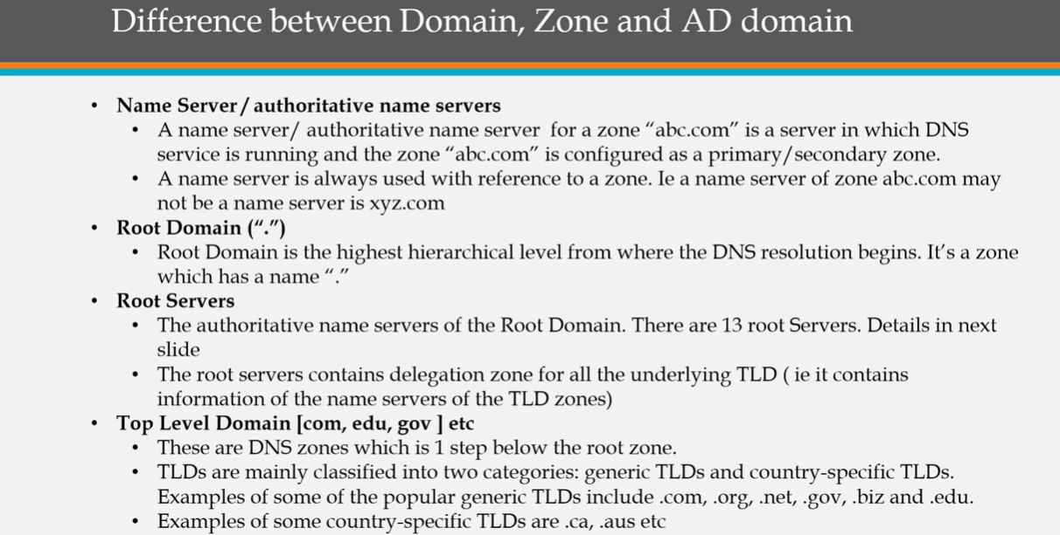

Slide 16
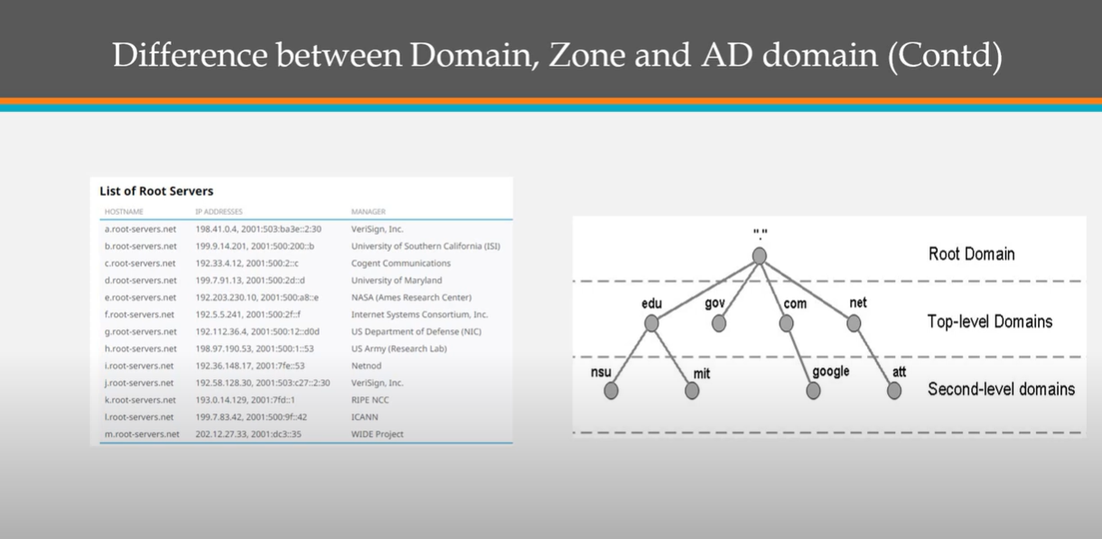

Slide 17
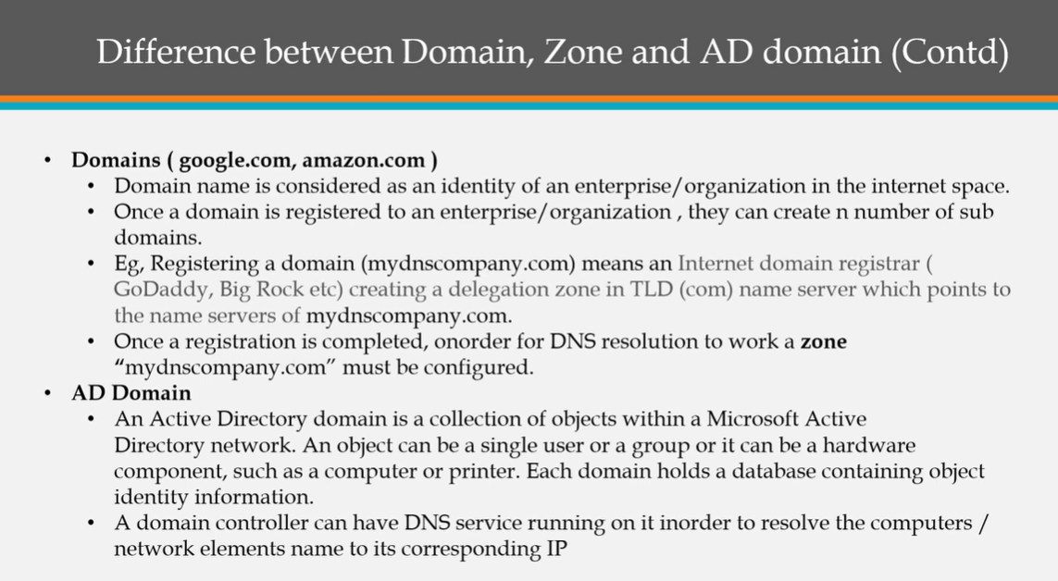

Slide 18
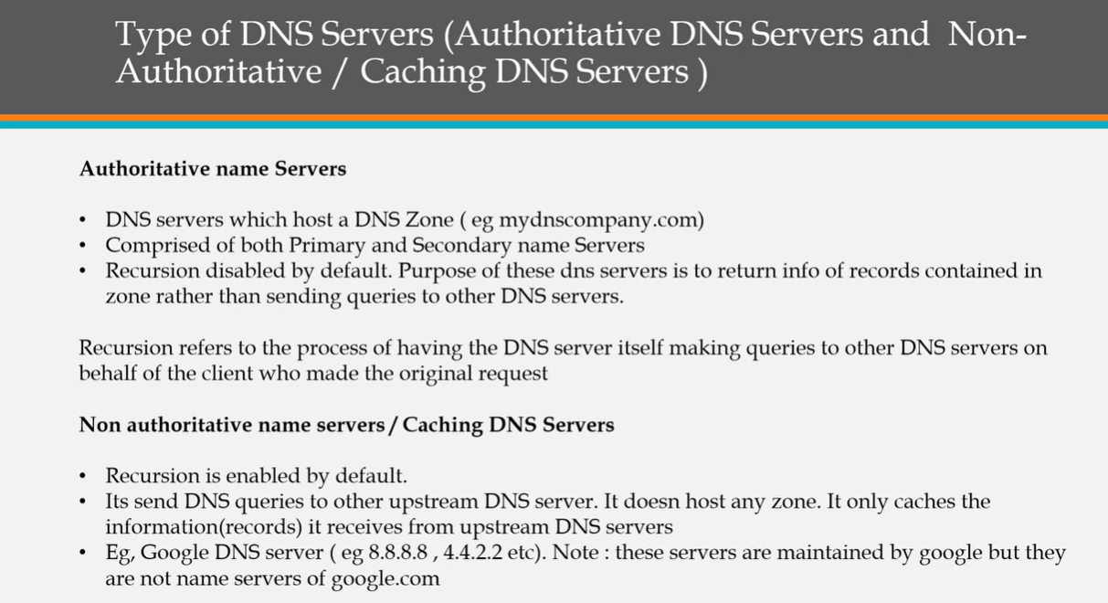

Slide 19
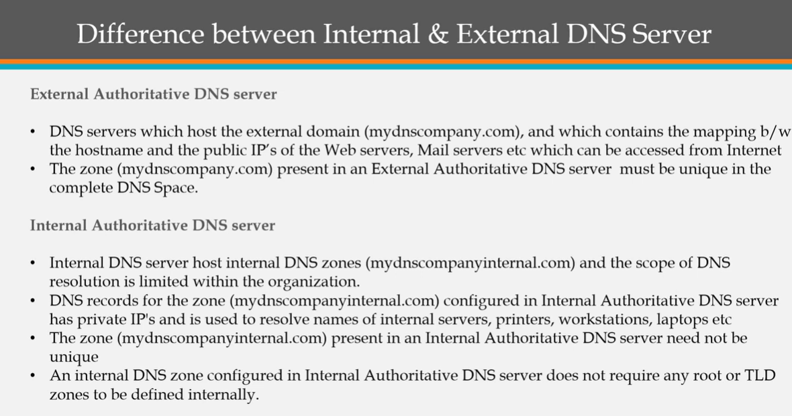

Slide 20
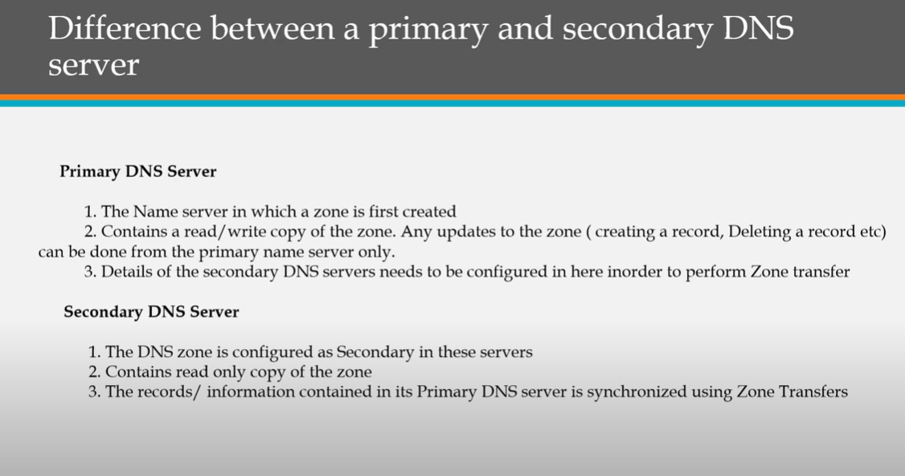

Slide 21
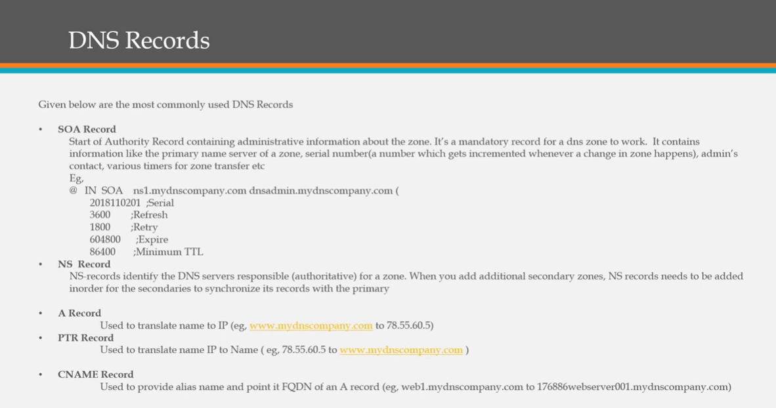

Slide 22
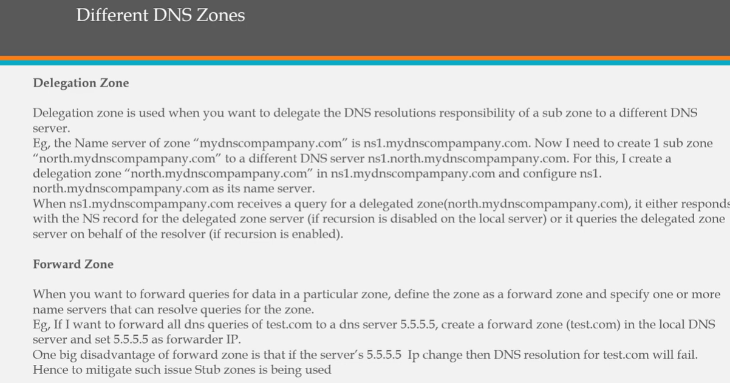

Slide 23
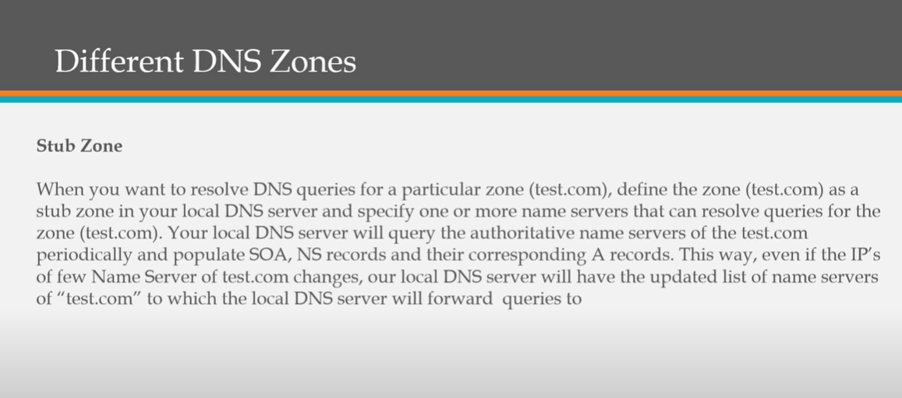

Slide 24
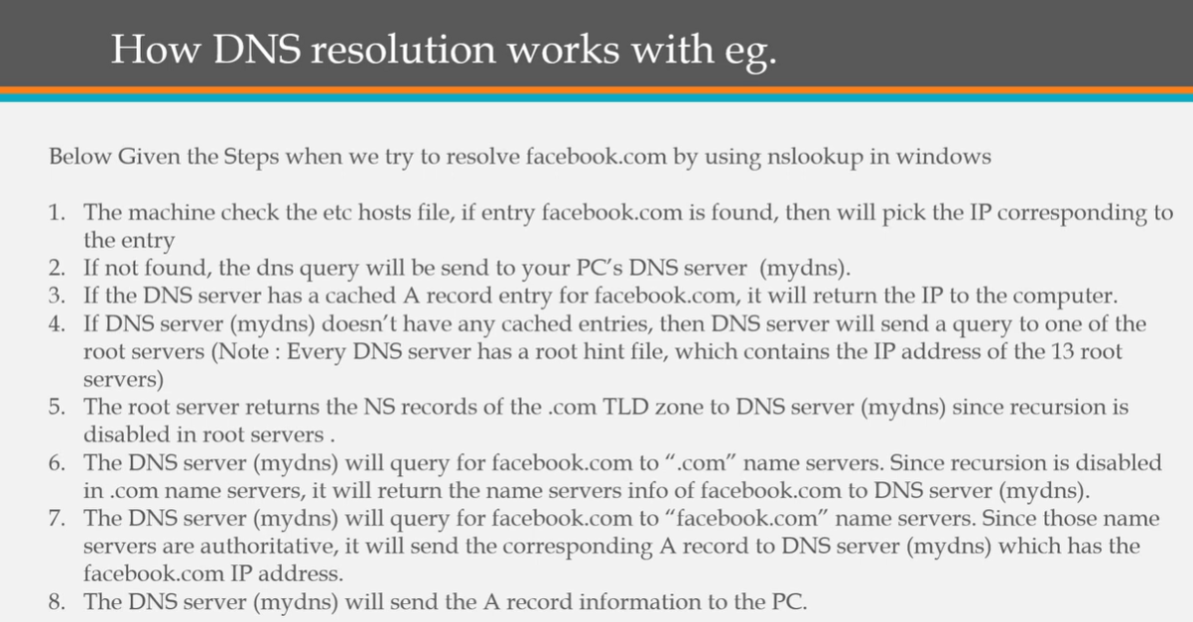

Slide 25
DHCP Service Infoblox
When a DHCP client requests an IP address, it sends a DHCPDISCOVER message to the router, which can act as a relay agent.
The router forwards the message to the DHCP server.
When the DHCP server receives the DHCPDISCOVER message, it determines the network segment to which the client belongs and assigns an IP address.
The DHCP server then sends a DHCPOFFER message that includes the IP address and other network configuration information.
When the router receives the DHCPOFFER message, it broadcasts the message to the client that sent the DHCPDISCOVER message.

Slide 26
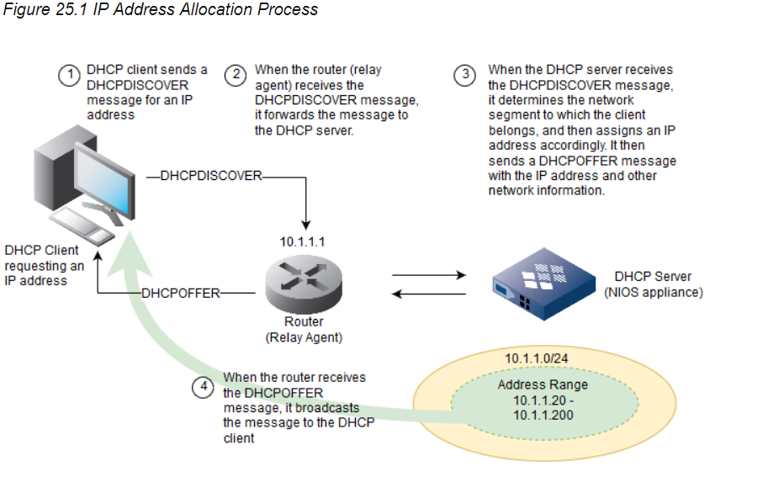

Slide 27
Configuring DHCP ping Status
When a DHCP client first tries to connect to a network, it broadcasts its request for an IP address. When the appliance receives such a request, it checks its record of assigned IP addresses and leases.
Because there are a limited number of IP addresses available, the appliance reassigns IP addresses whose leases might have expired. Therefore, once the appliance selects a candidate IP address for lease, it sends an ICMP echo request (or ping) to the IP address to verify that it is not in use.
If the appliance receives a response, this indicates that the IP address is still in use. Note that the lease status for this IP address is Abandoned. Only after the DHCP client broadcasts a new request for an IP address that the appliance selects another candidate IP address and sends it a ping.
This flow continues until the appliance finds an IP address that does not respond to the ping

Slide 28
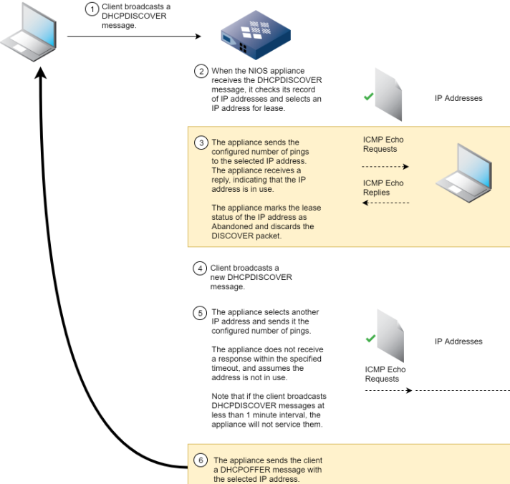

Slide 29
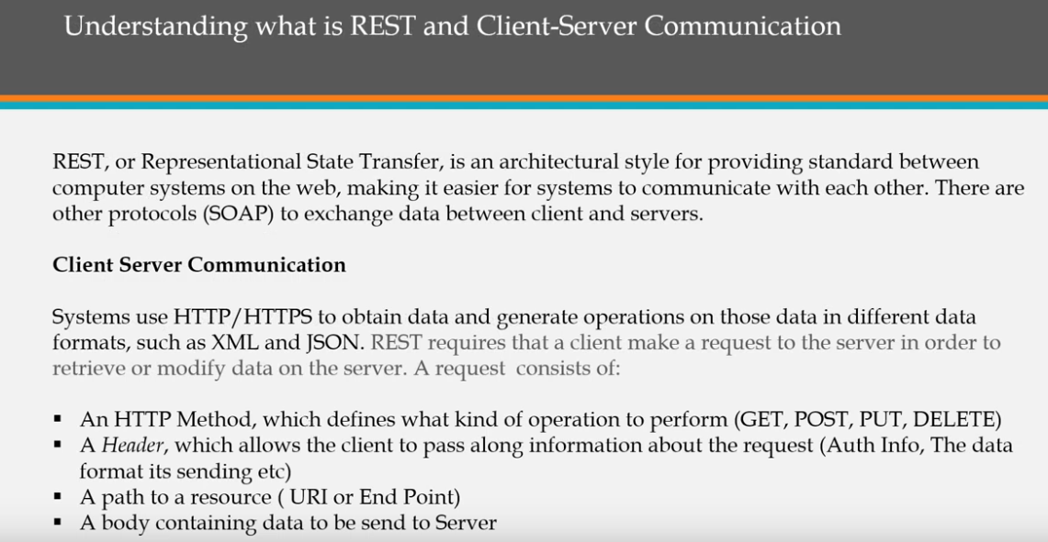

Slide 30
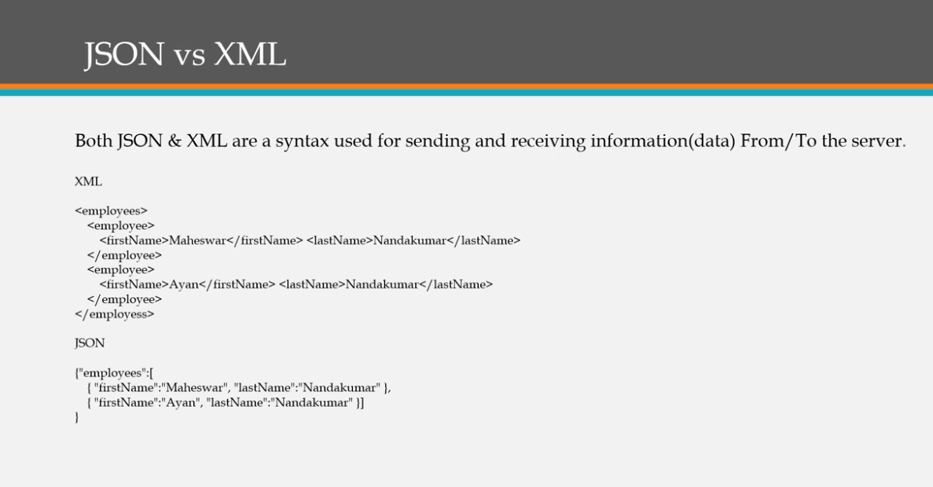

Slide 31
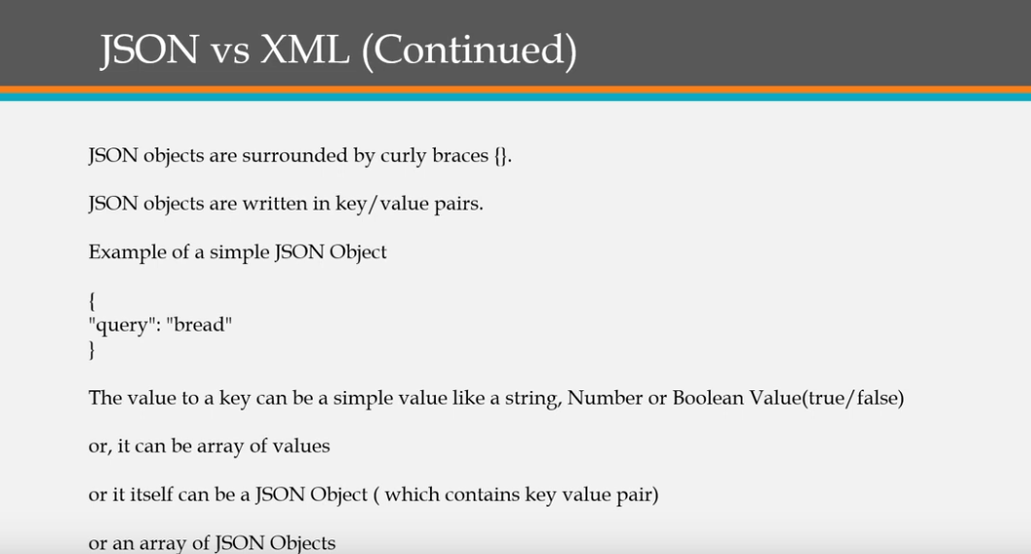

Slide 32
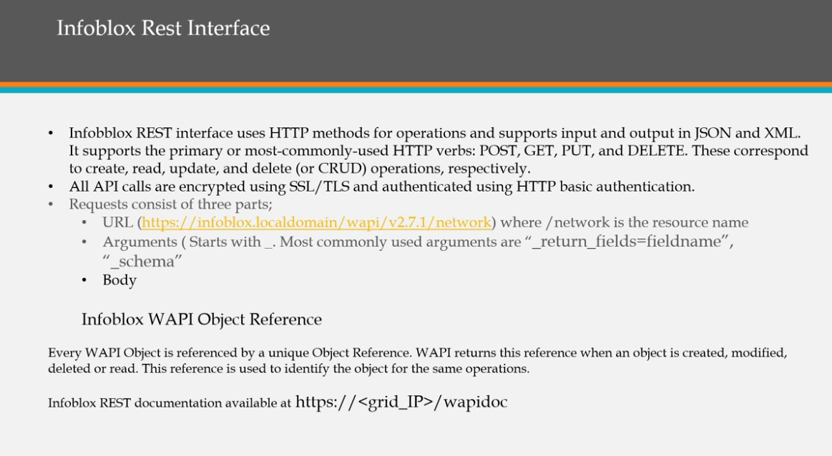

Slide 33
CLI Commands
ddns_add
ddns_delete
dig
Traceroute
Set commands
Show commands
Shutdown
Delete
Ping
reset log, reset database

Slide 34
Phantom Domain attack
A phantom domain attack happens when the attacker sets up "phantom" domains that do not respond to DNS queries.
Under normal circumstances, the DNS recursive server contacts authoritative servers to resolve recursive queries.
When phantom domain attacks happen, the recursive server continues to query non-responsive servers, which causes the recursive server to spend valuable resources waiting for responses.
When resources are fully consumed, the DNS recursive server may drop legitimate queries, causing serious performance issues.

Slide 35
DNSSEC
DNSSEC (DNS Security Extensions) provides mechanisms for authenticating the source of DNS data and ensuring its integrity.
It protects DNS data from certain attacks, such as man-in the middle attacks and cache poisoning.
A man-in-the middle attack occurs when an attacker intercepts responses to queries and inserts false records.
Cache poisoning can occur when a client accepts maliciously created data.
DNSSEC uses public key cryptography to authenticate the source of DNS responses and to ensure that DNS responses were not modified during transit. Public key cryptography uses an asymmetric key algorithm. With asymmetric keys, one key is used to decrypt data that was encrypted using the other key.

Slide 36
NSSEC uses the EDNS0 message extension. Resolvers include the EDNS OPT pseudo-RR with the DO (DNSSEC OK) bit set to indicate that they are requesting DNSSEC records.
A DNS client or resolver sets the EDNS DO bit when it sends a query for data in a signed zone.
When the DNS server receives such a query, it includes the additional DNSSEC records in its response, according to the DNSSEC standard rules.
In addition, because DNSSEC messages are often large, the EDNS0 message extension also provides mechanisms for handling larger DNS UDP messages.
When an authoritative name server digitally signs a zone, it typically generates two key pairs, a zone-signing key (ZSK) pair and a key-signing key (KSK) pair.
The name server uses the private key of the ZSK pair to sign each RRset in a zone (an RRset is a group of resource records that are of the same owner, class, and type.).
It stores the public key of the ZSK pair in a DNSKEY record. The name server then uses the private key of the KSK pair to sign all DNSKEY records, including its own, and stores the corresponding public key in another DNSKEY record.
As a result, a zone typically has two DNSKEY records; a DNSKEY record that holds the public key of the ZSK pair, and another DNSKEY record for the public key of the KSK pair.

Slide 37
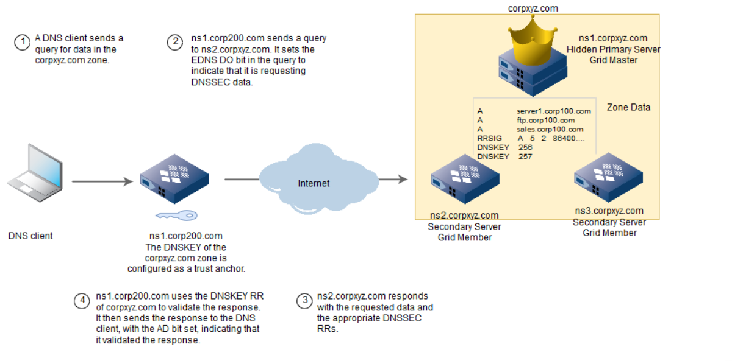

Slide 38
DNS Firewall
Infoblox DNS Firewall employs DNS RPZs (Response Policy Zones), a technology developed by ISC (Internet System Consortium) for allowing reputable sources to dynamically communicate domain name reputation so you can implement policy controls for DNS lookups.
On an Infoblox appliance, you can configure RPZs and define RPZ rules to block DNS resolution for malicious or unauthorized hostnames, or redirect clients to a walled garden by substituting responses.
Infoblox DNS Firewall supports both IPv4 and IPv6 networks. It also facilitates the detection of malware and APTs (Advanced Persistent Threats) by integrating the NIOS appliance with a FireEye appliance.
An Infoblox Grid performs RPZ actions for queries that originate from external sources. The name server recursive cache on an RPZ enabled Grid member uses the address of the client from which the query originates to identify if the query is generated from an external source or an internal Grid.
If the query originates from a Grid Master or a Grid member that has RPZ license installed, RPZ actions are automatically bypassed for those queries

Slide 39
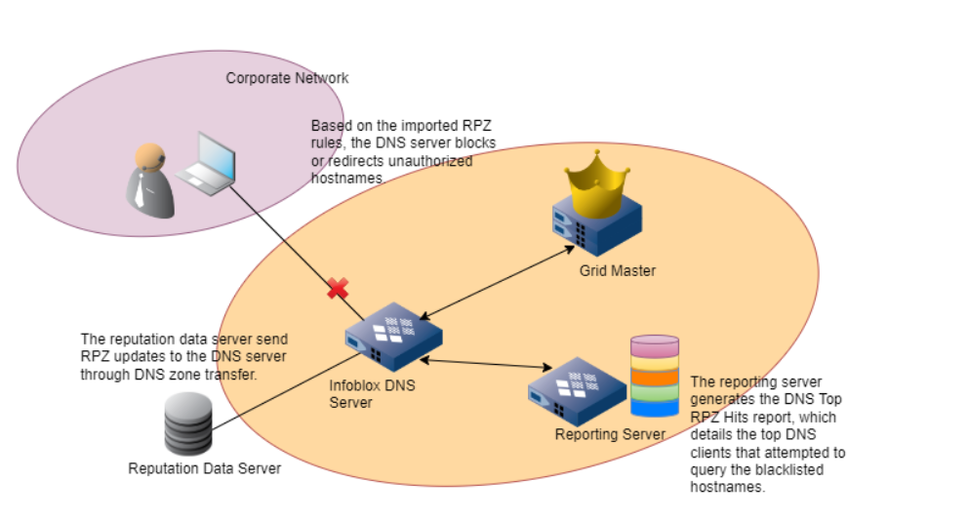

Slide 40
There are three types of RPZs:
Local RPZ – A local RPZ is a zone that allows administrators to define multiple response policies locally. Responses sent are based on the defined rules.
RPZ Feed – An RPZ feed receives response policies from external sources. DNS clients receive responses based on the imported rules from a reputable source, such as a commercial RPZ provider.
FireEye integrated RPZ – By integrating the NIOS appliance with the FireEye appliance, you can detect malware and APTs and take necessary actions to mitigate those threats.
The rules are classified as follows:
Passthru Rule
Block (No Such Domain) Rule
Block (No Data) Rule
Substitute (Domain Name) Rule
Substitute (Record) Rule

Slide 41
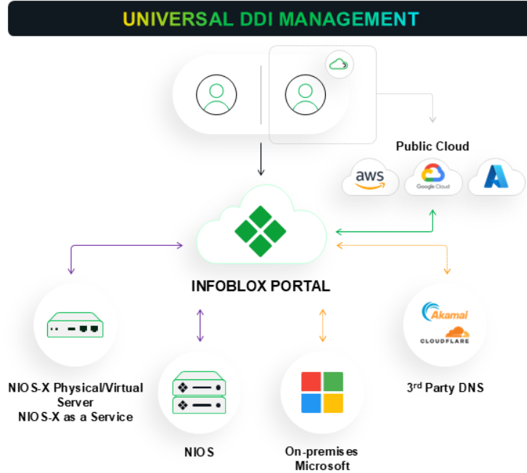
Universal DDI

Slide 42
BloxOne Cloud
Universal DDI Management, coupled with Universal Asset Insights and NIOS-X as a Service, enables organizations to simplify DDI management (DNS, DHCP, and IP address management) across on-premises environments and public clouds by offering unified management, in-depth visibility and insights, and infrastructure-free deployment.
Universal DDI Management consolidates configuration and control of several DDI services, including Microsoft DNS, BIND, NIOS Grid deployments, NIOS-X Physical and Virtual Servers (formerly BloxOne hosts or on-prem hosts), new NIOS-X as a Service (formerly DDI-as-a-Service), Amazon Route 53, Azure DNS and Google Cloud DNS.
Infoblox tailors its offerings to suit your specific network architecture and deployment needs, recognizing that different scenarios require distinct solutions.

Slide 43
Whether you operate with a centralized IT department, manage multiple branch offices each bolstered by their own IT teams or oversee distributed teams and remote workers, Infoblox has a solution for you. Our versatile suite of options includes deploying an on-premise solution for those who prefer local control, opting for a cloud-based solution to leverage the flexibility and scale of the cloud. Here are the solutions provided:
NIOS: An on-premise solution designed to be deployed within your own network infrastructure, providing a secure and controlled environment.
Infoblox Platform: This is a hybrid cloud-based solution that incorporates an on-premise component, offering the best of both worlds by combining the scalability of cloud computing with the control and security of local deployment.
Third Party Cloud Providers: The Infoblox Portal enables the management of objects from AWS, Azure, and GCP with two-way synchronization. Any modifications made to these objects in the third-party cloud providers will be instantly reflected in the Infoblox Portal. Likewise, any changes made to the third-party cloud objects within the Infoblox Portal will seamlessly reflect in their respective third-party cloud providers.

Slide 44
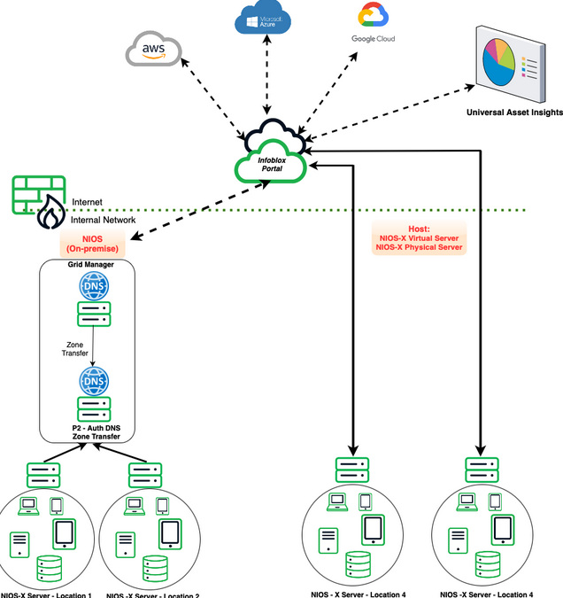

Slide 45
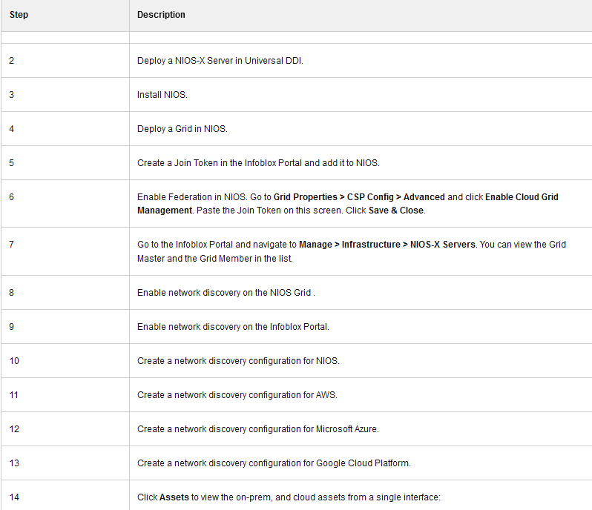

Slide 46
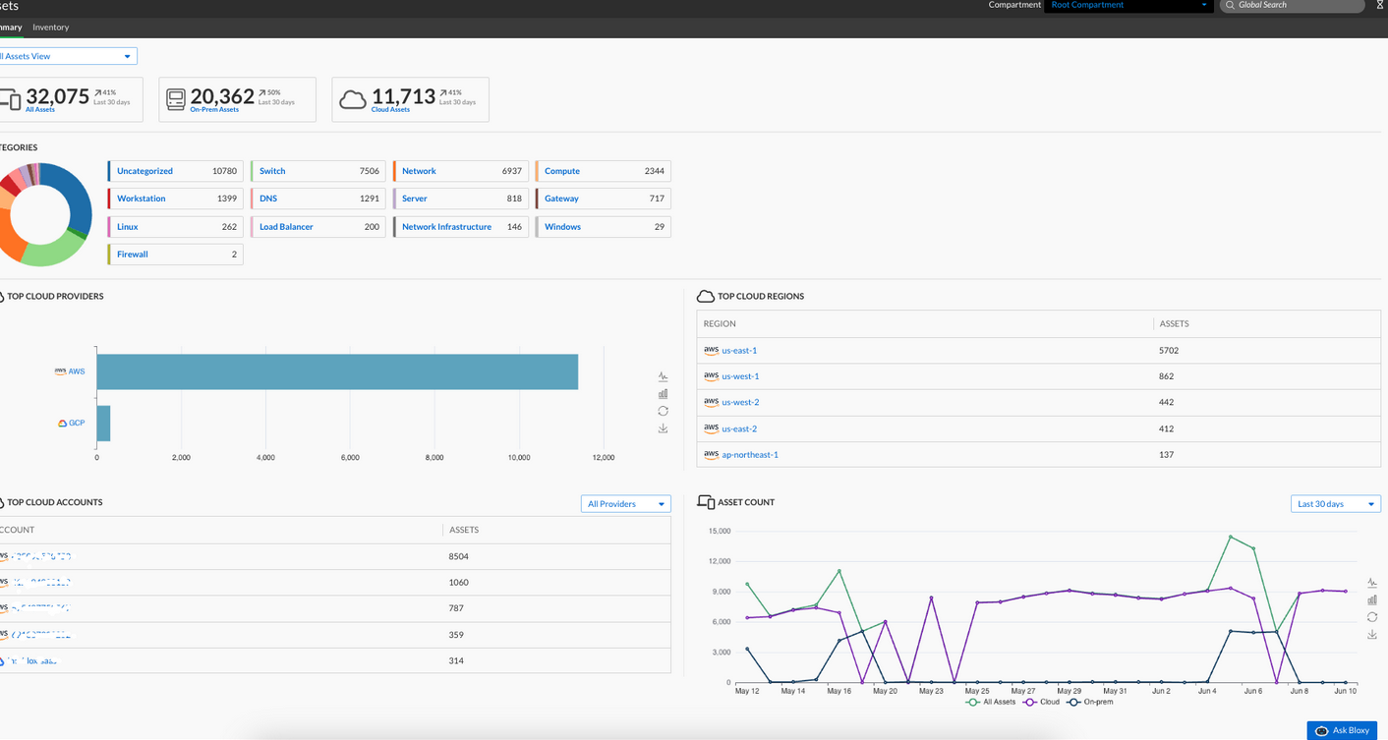

Slide 47
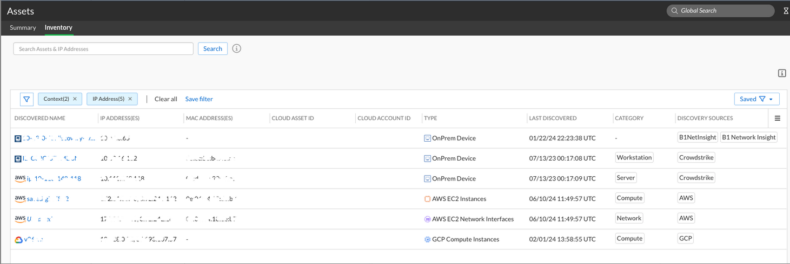

Slide 48
Tokens in CSP Portal
A join token is a special-purpose, system-generated alphanumeric string used to authenticate a NIOS-X virtual server, which can then automatically associate itself with its user account and establish a connection to the Infoblox services. To deploy an endpoint, create a join token, and then issue it to the corresponding endpoint.
Create as many join tokens as you need, and use them for different purposes, such as the following:
Use the same join token to deploy multiple NIOS-X virtual servers.
Create a join token to provision a set of remote devices, and assign them to your Infoblox Portal account.
Create a short-lived join token for an admin who wants to join NIOS-X servers. When the admin finishes the task, revoke the join token and thus prevent the admin from provisioning new servers.
Revoke a join token if it has been compromised, to prevent its use in provisioning of new NIOS-X servers. If you use a revoked token, a server cannot establish a new connection to the Infoblox Platform. However, the server will keep an existing connection. Note that join tokens are valid until you revoke them through the Infoblox Portal.
Configure > Administration > Join Tokens

Slide 49
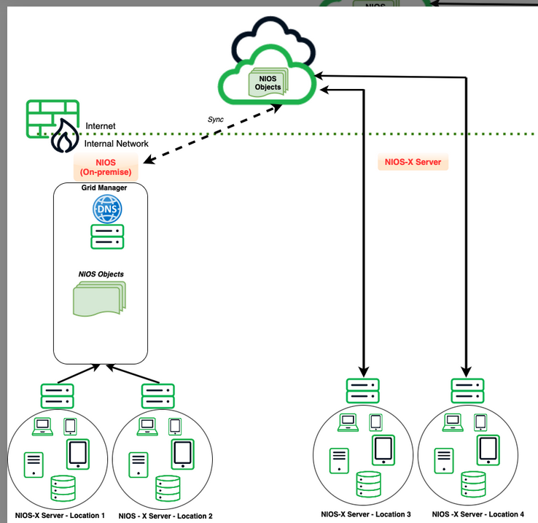

Slide 50
IPAM Federation
Problems with overlapping IP addresses can occur when various IPAM (IP Address Management) services, including on-premise solutions like NIOS and cloud providers such as Amazon Web Services (AWS), Microsoft Azure, and Google Cloud Platform (GCP) are deployed across the network without a centralized management console that manages all on-premise and cloud providers.
This can lead to conflicts in routing and addressing, potentially causing network communication problems. IPAM Federation solves this problem.
The purpose of the IPAM Federation service is to manage and organize unique address spaces that are required across IP spaces, namespaces, or views by maintaining federated block of IP addresses and delegating ownership of those blocks to other IPAM services.
IPAM Federation provides a method to manage network address blocks to a federation of IPAM contexts in Universal DDI, NIOS, or any other cloud IPAM providers.

Slide 51
IPAM Federation contains the following objects:
Federated Realm - A realm serves as a named container for a group of objects, establishing a distinct namespace for IPv4 and IPv6 addressing.
Federated Block - CIDR notation prefix for globally unique address range which can be used for further allocation.
Delegation - A CIDR notation prefix represents an address range that has been delegated to another cooperating IPAM service.
Overlapping Block - A CIDR notation prefix representing an address range for which authority is expressly abandoned. Cooperating IPAM services may allocate overlapping prefixes from this block, with the understanding that they will never route to each other (for example, used behind a NAT gateway).
Reserved Block - A Reserved Block is a CIDR notation prefix representing an address range for which authority is expressly forbidden. Cooperating IPAM services must not allocate overlapping prefixes from this block.
Configure > Networking > IPAM Realms.

Slide 52
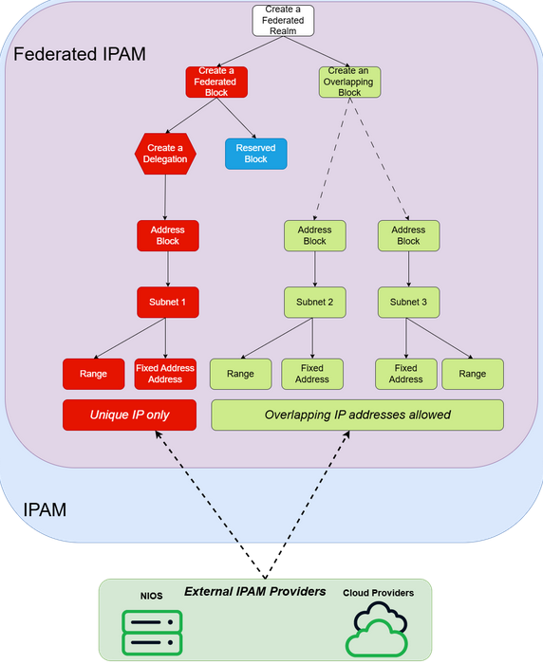

Slide 53
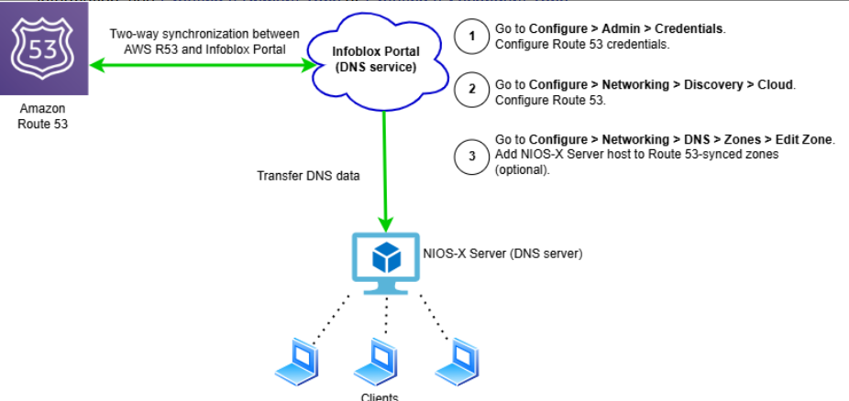
Amazon Route 53 is a cloud DNS web service that routes end users’ requests to internet applications and resources by resolving domain names into IP addresses and IP addresses into domain names. In Amazon Route 53, DNS records are organized into hosted zones, which are configured through the Route 53 API, AWS CLI, or AWS Management Console.
Universal DDI provides the capability for synchronizing and integrating public-hosted zones with Amazon Route 53, and this allows users to view and manage Route 53 DNS data through the Infoblox Portal. Also, NIOS-X Servers can be configured to service zones synchronized from Route 53.

Slide 54
Azure DNS is a cloud DNS web service that routes end users’ requests to internet applications and resources by resolving domain names into IP addresses and IP addresses into domain names. In Azure, DNS records are organized into hosted zones, which are configured through the Azure API, Azure CLI, or Azure Resource Manager.
Universal DDI provides the capability for synchronizing and integrating public-hosted zones with Azure, and this allows users to view and manage Azure DNS data through the Infoblox Portal. Also, BloxOne NIOS-X Servers can be configured to service zones synchronized from Azure. For more information about Azure DNS, refer to the Azure DNS documentation.
Google Cloud Platform (GCP) is a comprehensive suite of cloud computing services offered by Google, providing scalable and flexible solutions for compute, storage, networking, big data, machine learning, and application development. It includes services like Compute Engine for virtual machines, Kubernetes Engine for container orchestration, and BigQuery for data analytics, all running on Google's highly reliable infrastructure.
Universal DDI provides the capability for synchronizing and integrating public-hosted zones with GCP, and this allows users to view and manage GCP DNS data through the Infoblox Portal. Also, NIOS-X Servers can be configured to service zones that have been synchronized from GCP.

